Slide 1
Array, DUP and Source Index
8086 / NASM Assembly Language
• Arrays allow many related values to be stored under a single variable name.
• Array elements are stored sequentially in memory.
• DUP simplifies initialization when the same value is repeated.
• The SI (Source Index) register can be used as a pointer to access array elements.

Slide 2
Why Use an Array?
• Suppose we have four variables: 1, 2, 3, and 4.
• If each value is declared separately, every variable has its own name.
• When initialized, the values occupy memory locations.
• It is better to store related values with a single variable name when they form a sequence.
var1 db 1
var2 db 2
var3 db 3
var4 db 4
Values in memory
1
2
3
4

Slide 3
Array: Single Name for Sequential Data
• Example: instead of four separate variable names, use one array name.
• The values are stored sequentially in memory.
• An array is a collection of characters/values in sequence.
• This makes it easier to process multiple related values using indexing.
var1 db 1, 2, 3, 4
Sequential storage
1
2
3
4

Slide 4
Array Definition and Initialization
• Arrays are defined in the .data section.
• The program itself is written in the .text/code section.
• An array is initialized in the same way as a variable, but with multiple values.
• For byte arrays, use DB (Define Byte).
section .data
Arr1 db 1, 2, 3, 4
Arr1 db 'a', 'b', 'c'
Arr1 db 'abc'
section .text
global _start
_start:

Slide 5
Using DUP to Repeat a Value
• When the same character/value occurs repeatedly, DUP can duplicate it.
• General form: array_name db number_of_elements DUP(value)
• Example: Arr1 db 3 DUP('a') creates three byte elements containing 'a'.
• DUP is useful for creating repeated or reserved storage efficiently.
Arr1 db 3 DUP('a')
Resulting array
'a'
'a'
'a'

Slide 6
Where to Initialize an Array
• Array declarations are placed in the data directive/section.
• The program code is placed in the code/text section.
• In the notes, the model is represented as:
• model small
• stack 100H
• data
• code
• main proc
.model small
.stack 100H
.data
Arr1 db 1,2,3,4
.code
main proc
; program instructions
main endp
end main

Slide 7
How to Access an Array
• SI (Source Index) can be used as a pointer to access an array.
• First load SI with the address/offset of the first array element.
• Use [SI] to access the value at the address contained in SI.
• SI can then be incremented to access the next byte.
• The notes compare SI to a postman: it points to the location from which data is taken.
mov si, offset Arr1
mov dl, [si]
mov ah, 2
int 21h
; next element
mov dl, [si+1]
; OR
inc si
mov dl, [si]
mov ah, 2
int 21h
main endp
end main

Slide 8
Array Addressing Example
• Assume Arr1 contains: 1, 2, 3, 4.
• If the first element starts at AH000, the next byte elements are at consecutive addresses.
• Therefore [SI] accesses the first element when SI points to AH000.
• [SI+1] accesses the next byte without changing SI.
• Alternatively, INC SI changes SI so that [SI] accesses the next element.
Example memory layout
AH000
1
AH001
2
AH002
3
AH003
4
SI → first element
SI + 1 → next element

Slide 9
Complete Example: Reading Array Elements
section .data
Arr1 db 'a', 'b', 'c'
section .text
global _start
_start:
mov si, Arr1
mov dl, [si]
mov ah, 2
int 21h
mov dl, [si+1]
mov ah, 2
int 21h
mov dl, [si+2]
mov ah, 2
int 21h
; exit (DOS-style examples may vary)
Note: In MASM/TASM syntax, OFFSET Arr1 is commonly used to obtain the array address; NASM syntax depends on the target format.

Slide 10
Summary
• An array stores multiple values using one variable name.
• Array elements are stored sequentially in memory.
• DB initializes byte-sized array elements.
• DUP repeats a specified value a specified number of times.
• SI can act as a source-index pointer for array access.
• [SI] accesses the element at the current address.
• [SI+1] accesses the next byte, while INC SI moves the pointer.
• Arrays simplify storage and processing of related data.

Slide 11
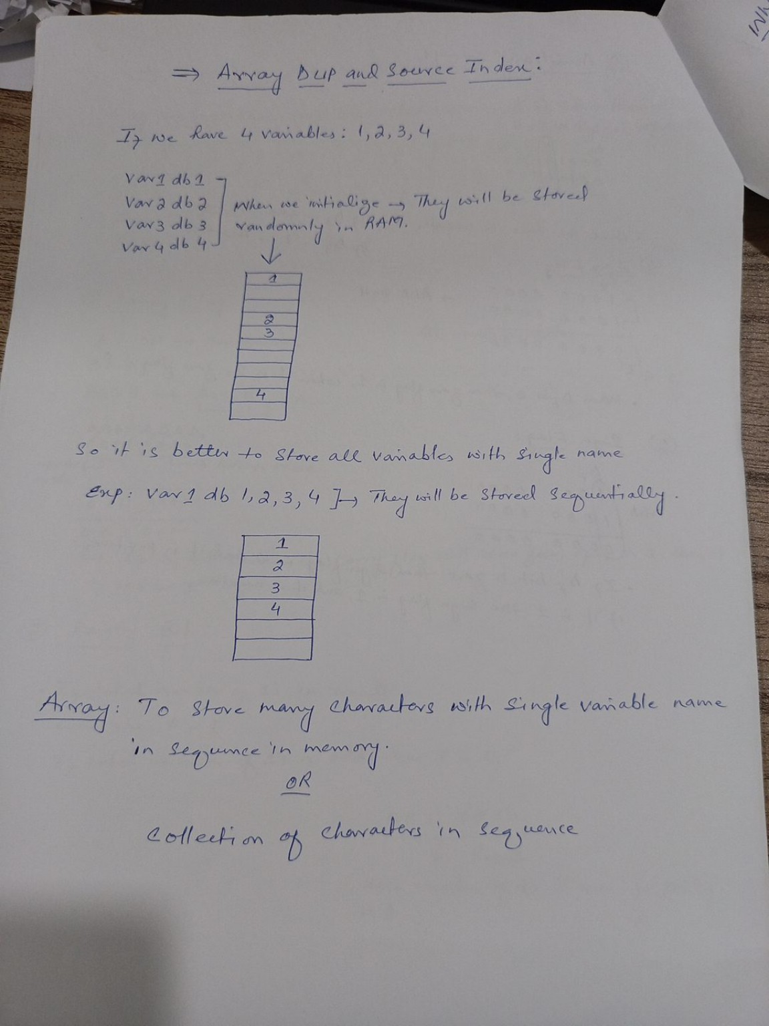
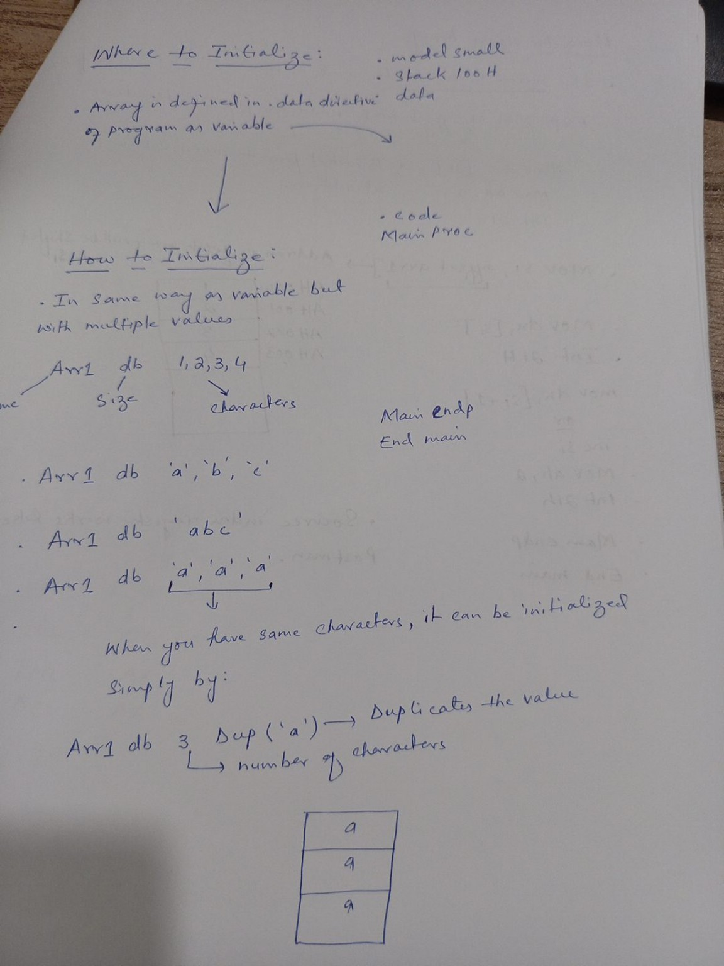
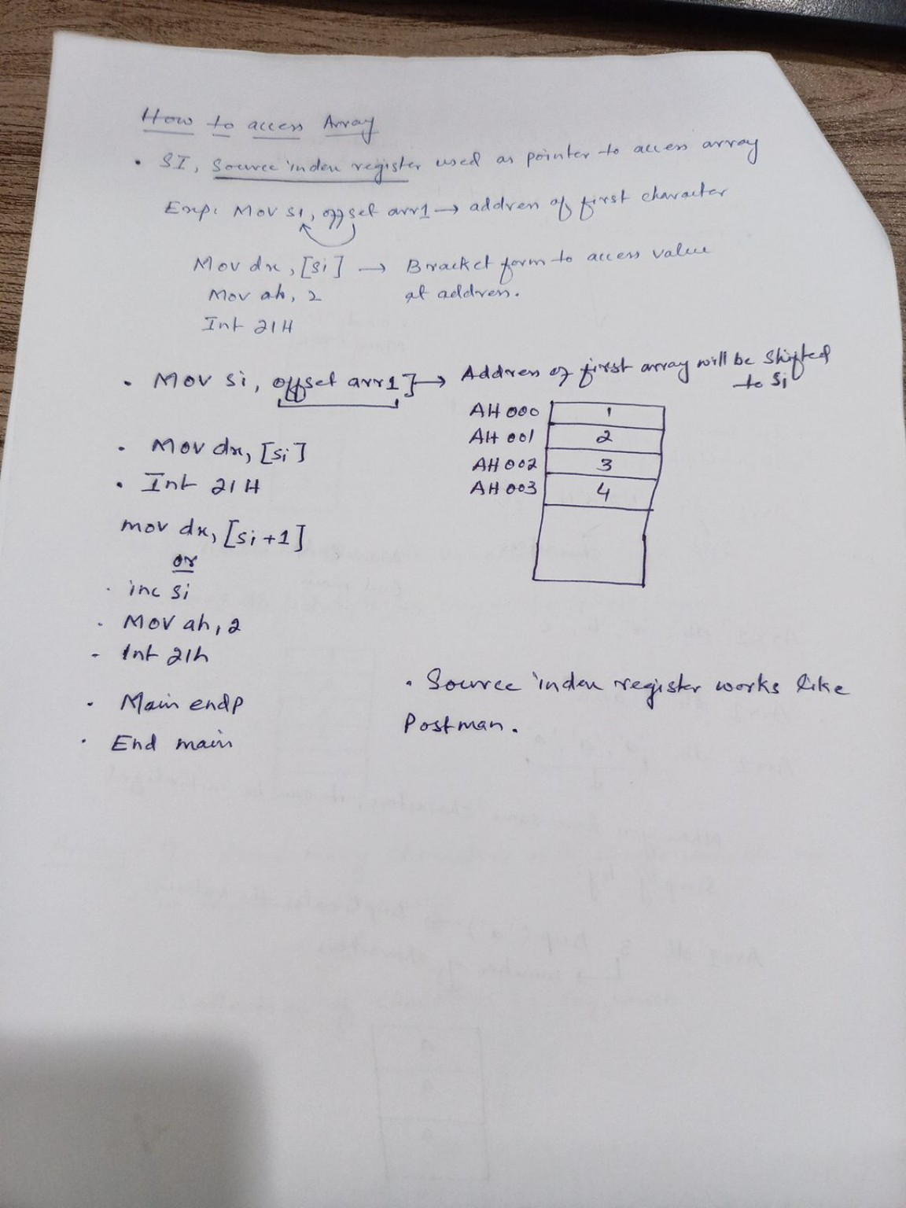
Original Notes – Reference

